Slide 1

Data Structures and Abstractions with Java
Chapter 25
Tree Implementations

Slide 2
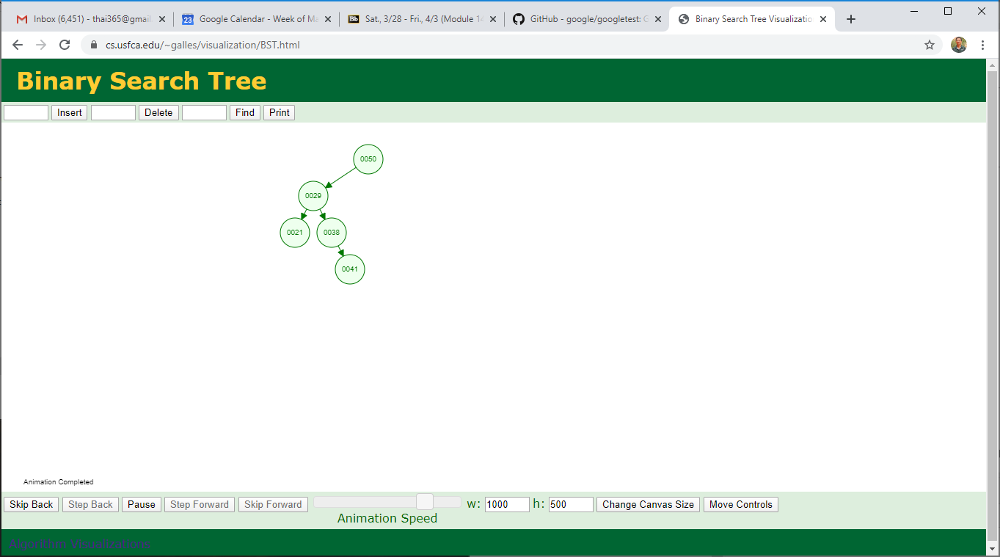
Review | Example
Reconstruct the tree
[50, 29, 38, 21, 41]
Reconstruct a tree from 1+ traversals
What type of tree is this, Binary or BST?
Is it a heap?
Notes:
Binary vs. binary search trees?
Is this a heap?

Slide 3
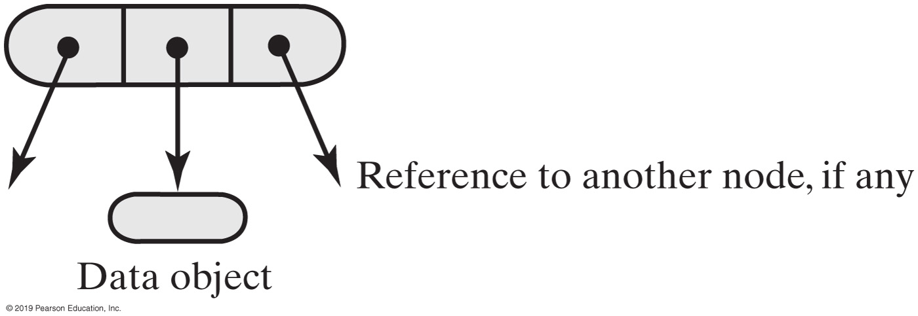
Binary Tree Nodes
Notes:
Characteristics of a binary tree node

Slide 4
Binary Tree Node (1 of 4)
/** A class that represents nodes in a binary tree. */
class BinaryNode<T>
{
private T data;
private BinaryNode<T> leftChild; // Reference to left child
private BinaryNode<T> rightChild; // Reference to right child
public BinaryNode()
{
this(null); // Call next constructor
} // end default constructor
public BinaryNode(T dataPortion)
{
this(dataPortion, null, null); // Call next constructor
} // end constructor
public BinaryNode(T dataPortion, BinaryNode<T> newLeftChild,
BinaryNode<T> newRightChild)
{
data = dataPortion;
leftChild = newLeftChild;
rightChild = newRightChild;
} // end constructor
Notes:
Tree vs. Node (classes)

Slide 5
Binary Tree Node (2 of 4)
/** Retrieves the data portion of this node.
@return The object in the data portion of the node. */
public T getData(). {
return data;
} // end getData
/** Sets the data portion of this node.
@param newData The data object. */
public void setData(T newData) {
data = newData;
} // end setData
/** Retrieves the left child of this node.
@return A reference to this node's left child. */
public BinaryNode<T> getLeftChild()
{
return leftChild;
} // end getLeftChild
/** Sets this node’s left child to a given node.
@param newLeftChild A node that will be the left child. */
public void setLeftChild(BinaryNode<T> newLeftChild)
{
leftChild = newLeftChild;
} // end setLeftChild

Slide 6
Binary Tree Node (3 of 4)
/** Detects whether this node has a left child.
@return True if the node has a left child. */
public boolean hasLeftChild()
{
return leftChild != null;
} // end hasLeftChild
/* Implementations of getRightChild, setRightChild, and hasRightChild
are here and are analogous to their left-child counterparts. */
/** Detects whether this node is a leaf.
@return True if the node is a leaf. */
public boolean isLeaf()
{
return (leftChild == null) && (rightChild == null);
} // end isLeaf
/** Counts the nodes in the subtree rooted at this node.
@return The number of nodes in the subtree rooted at this node. */
public int getNumberOfNodes()
{
// < Coming later —— See Segment 25.10. >
} // end getNumberOfNodes

Slide 7
Binary Tree Node (4 of 4)
/** Computes the height of the subtree rooted at this node.
@return The height of the subtree rooted at this node. */
public int getHeight()
{
// < Coming later —- See Segment 25.10. >
} // end getHeight
/** Copies the subtree rooted at this node.
@return The root of a copy of the subtree rooted at this node. */
public BinaryNode<T> copy()
{
// < Coming later —— See Segment 25.5. >
} // end copy
} // end BinaryNode
All “right child” methods are missing (from these slides)
Notes:
All “right child” methods are missing (from these slides)

Slide 8
Methods within BinaryNode.
public int getHeight()
{
return getHeight(this); // Call private getHeight
} // end getHeight
private int getHeight(BinaryNode<T> node)
{
int height = 0;
if (node != null)
height = 1 + Math.max(getHeight(node.getLeftChild()),
getHeight(node.getRightChild()));
return height;
}

Slide 9
Methods within BinaryNode
public int getNumberOfNodes()
{
int leftNumber = 0;
int rightNumber = 0;
if (left != null)
leftNumber = left.getNumberOfNodes();
if (right != null)
rightNumber = right.getNumberOfNodes();
return 1 + leftNumber + rightNumber;
} // end getNumberOfNodes

Slide 10
Binary Tree | Interface
/** An interface for the ADT binary tree. */
public interface BinaryTreeInterface<T> extends TreeInterface<T>,
TreeIteratorInterface<T>
{
/** Sets the data in the root of this binary tree.
@param rootData The object that is the data for the tree's root.
*/
public void setRootData(T rootData);
/** Sets this binary tree to a new binary tree.
@param rootData The object that is the data for the new tree's root.
@param leftTree The left subtree of the new tree.
@param rightTree The right subtree of the new tree. */
public void setTree(T rootData, BinaryTreeInterface<T> leftTree,
BinaryTreeInterface<T> rightTree);
} // end BinaryTreeInterface

Slide 11
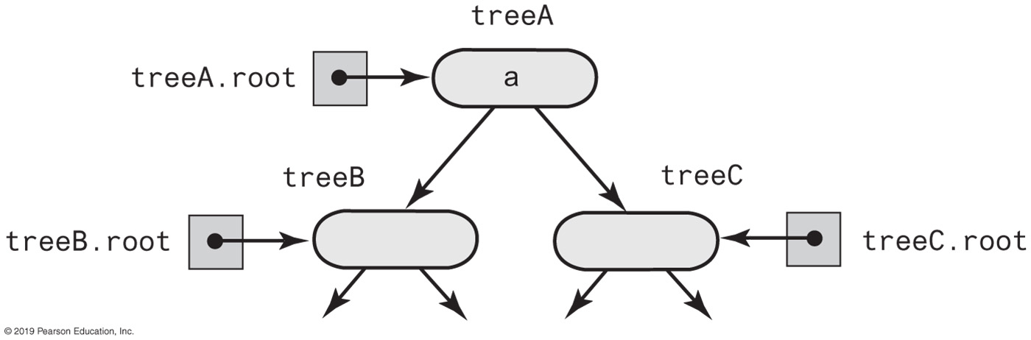
Creating a Binary Tree
treeA.setTree(a, treeB, treeC);

Slide 12
Creating a Basic Binary Tree (Part 1)
import java.util.Iterator;
import java.util.NoSuchElementException;
import StackAndQueuePackage.*; // Needed by tree iterators
/** A class that implements the ADT binary tree. */
public class BinaryTree<T> implements BinaryTreeInterface<T>
{
private BinaryNode<T> root;
public BinaryTree()
{
root = null;
} // end default constructor
public BinaryTree(T rootData)
{
root = new BinaryNode<>(rootData);
} // end constructor
public BinaryTree(T rootData, BinaryTree<T> leftTree, BinaryTree<T> rightTree)
{
initializeTree(rootData, leftTree, rightTree);
} // end constructor

Slide 13
Creating a Basic Binary Tree (Part 2)
public void setTree(T rootData, BinaryTreeInterface<T> leftTree,
BinaryTreeInterface<T> rightTree)
{
initializeTree(rootData, (BinaryTree<T>)leftTree,
(BinaryTree<T>)rightTree);
} // end setTree
private void initializeTree(T rootData, BinaryTree<T> leftTree,
BinaryTree<T> rightTree)
{
// < FIRST DRAFT - See Segments 25.4 - 25.7 for improvements. >
root = new BinaryNode<T>(rootData);
if (leftTree != null)
root.setLeftChild(leftTree.root);
if (rightTree != null)
root.setRightChild(rightTree.root);
} // end initializeTree
/* Implementations of setRootData, getRootData, getHeight, getNumberOfNodes,
isEmpty, clear, and the methods specified in TreeIteratorInterface are here.
. . . */
} // end BinaryTree

Slide 14
The Method copy
/** Copies the subtree rooted at this node. */
public BinaryNode<T> copy()
{
BinaryNode<T> newRoot = new BinaryNode<>(data);
if (leftChild != null)
newRoot.setLeftChild(leftChild.copy());
if (rightChild != null)
newRoot.setRightChild(rightChild.copy());
return newRoot;
} // end copy

Slide 15
The Method initializeTree
private void initializeTree(T rootData, BinaryTree<T> leftTree, BinaryTree<T> rightTree)
{
root = new BinaryNode<>(rootData);
if ((leftTree != null) && !leftTree.isEmpty())
root.setLeftChild(leftTree.root.copy());
if ((rightTree != null) && !rightTree.isEmpty())
root.setRightChild(rightTree.root.copy());
} // end initializeTree
Method initializeTree can invoke copy to copy the nodes from the two given subtrees

Slide 16
BinaryTree Accessor and Mutator Methods
public void setRootData(T rootData)
{
root.setData(rootData);
} // end setRootData
public T getRootData()
{
if (isEmpty())
throw new EmptyTreeException();
else
return root.getData();
} // end getRootData
protected void setRootNode(BinaryNode<T> rootNode)
{
root = rootNode;
} // end setRootNode
protected BinaryNode<T> getRootNode()
{
return root;
} // end getRootNode

Slide 17
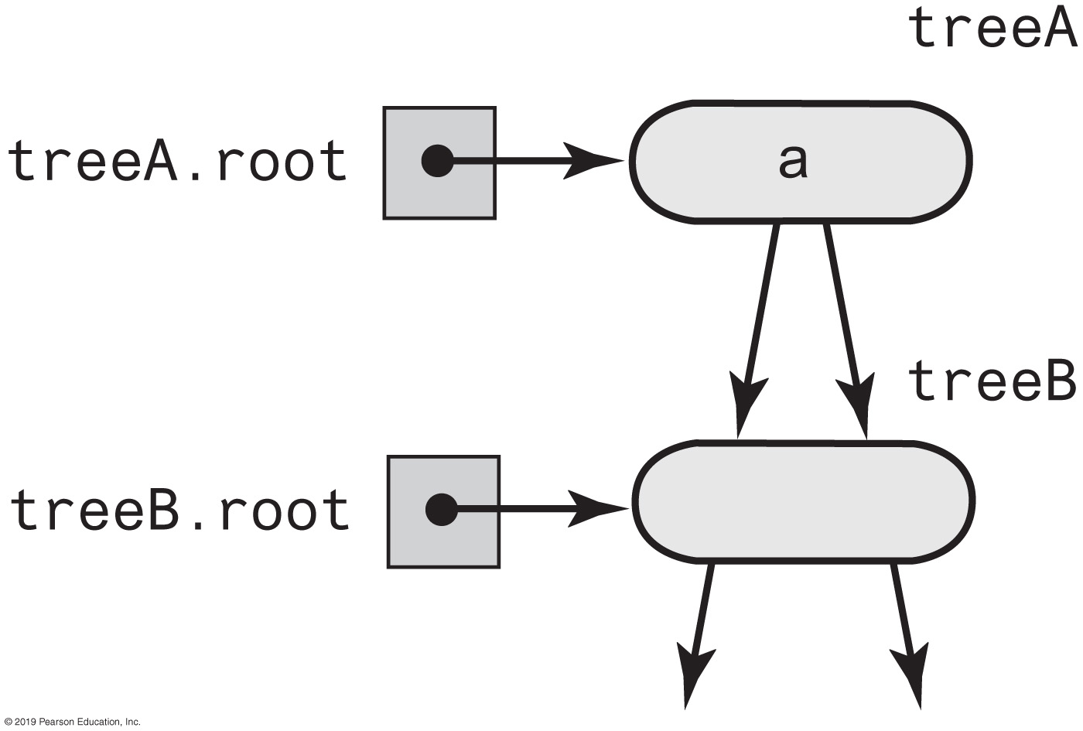
Additional Challenges

Slide 18
Method initializeTree Solution
If left subtree exists and not empty,
attach root node to r as left child.
Create root node r containing given data
If right subtree exists, not empty, and distinct from left subtree,
attach root node to r as a right child
But if right and left subtrees are same,
attach copy of right subtree to r instead
If the left subtree exists and differs from the tree object used to call initializeTree,
set the subtree’s data field root to null.
If right subtree exists and differs from the tree object used to call initializeTree,
set subtree’s data field root to null.

Slide 19
Method initializeTree Solution
private void initializeTree(T rootData, BinaryTree<T> leftTree,
BinaryTree<T> rightTree)
{
root = new BinaryNode<>(rootData);
if ((leftTree != null) && !leftTree.isEmpty())
root.setLeftChild(leftTree.root);
if ((rightTree != null) && !rightTree.isEmpty())
{
if (rightTree != leftTree)
root.setRightChild(rightTree.root);
else
root.setRightChild(rightTree.root.copy());
} // end if
if ((leftTree != null) && (leftTree != this))
leftTree.clear();
if ((rightTree != null) && (rightTree != this))
rightTree.clear();
} // end initializeTree

Slide 20
More BinaryTree Methods
public int getHeight()
{
int height = 0;
if (root != null)
height = root.getHeight();
return height;
} // end getHeight
public int getNumberOfNodes()
{
int numberOfNodes = 0;
if (root != null)
numberOfNodes = root.getNumberOfNodes();
return numberOfNodes;
} // end getNumberOfNodes
Computing the Height and Counting Nodes

Slide 21
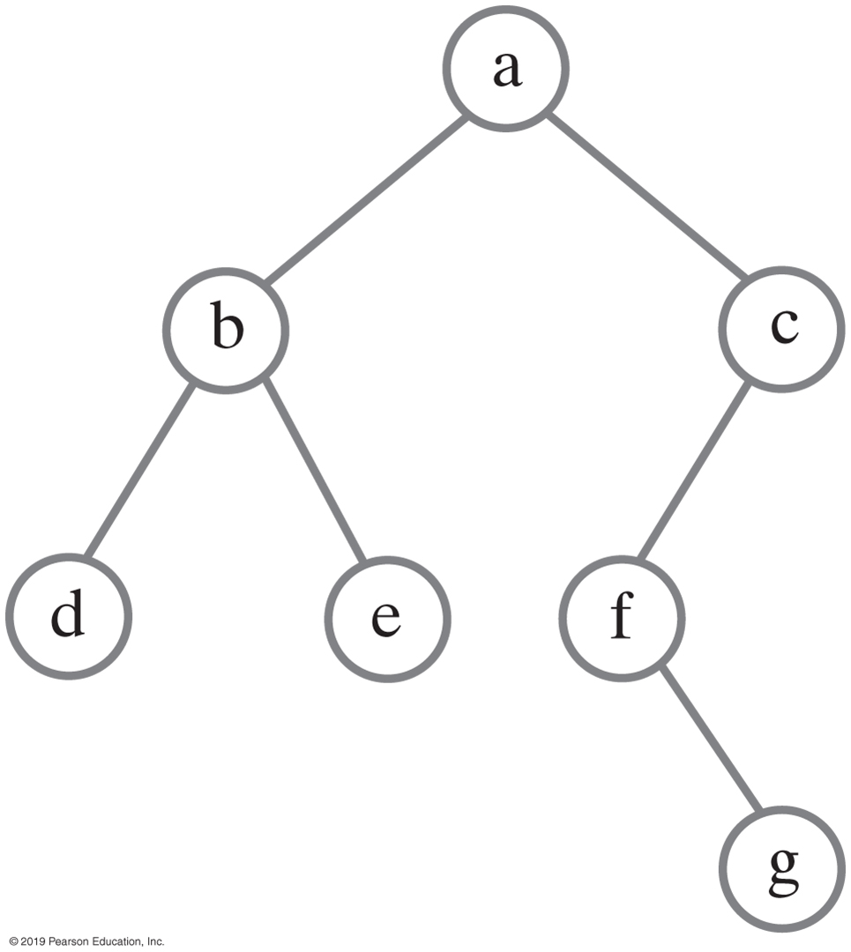
Traversing a binary tree recursively
public void inorderTraverse()
{
inorderTraverse(root);
} // end inorderTraverse
private void inorderTraverse(BinaryNode<T> node)
{
if (node != null)
{
inorderTraverse(node.getLeftChild());
System.out.println(node.getData());
inorderTraverse(node.getRightChild());
} // end if
} // end inorderTraverse

Slide 22
Traversals That Use An Iterator (Part 1)
private class InorderIterator implements Iterator<T>
{
private StackInterface<BinaryNode<T>> nodeStack;
private BinaryNode<T> currentNode;
public InorderIterator()
{
nodeStack = new LinkedStack<>();
currentNode = root;
} // end default constructor
public void remove()
{
throw new UnsupportedOperationException();
} // end remove
public boolean hasNext()
{
return !nodeStack.isEmpty() || (currentNode != null);
} // end hasNext

Slide 23
Traversals That Use An Iterator (Part 2)
public T next()
{
BinaryNode<T> nextNode = null;
// Find leftmost node with no left child
while (currentNode != null)
{
nodeStack.push(currentNode);
currentNode = currentNode.getLeftChild();
} // end while
// Get leftmost node, then move to its right subtree
if (!nodeStack.isEmpty())
{
nextNode = nodeStack.pop();
// Assertion: nextNode != null, since nodeStack was not empty
// before the pop
currentNode = nextNode.getRightChild();
}
else
throw new NoSuchElementException();
return nextNode.getData();
} // end next
} // end InorderIterator

Slide 24
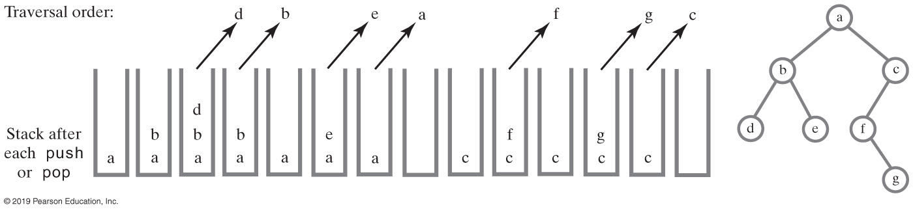
Non-recursive Traversal
Using a stack to perform an in-order traversal of a binary tree

Slide 25
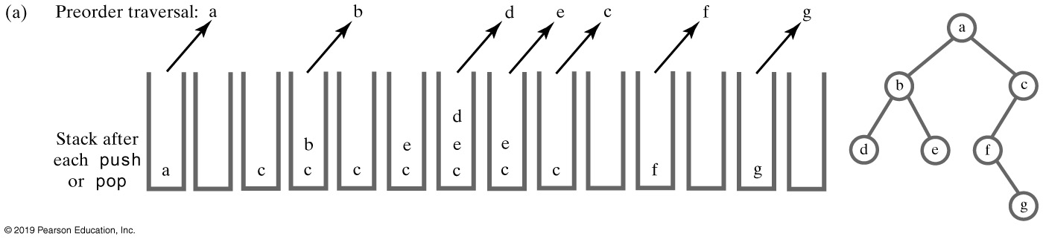
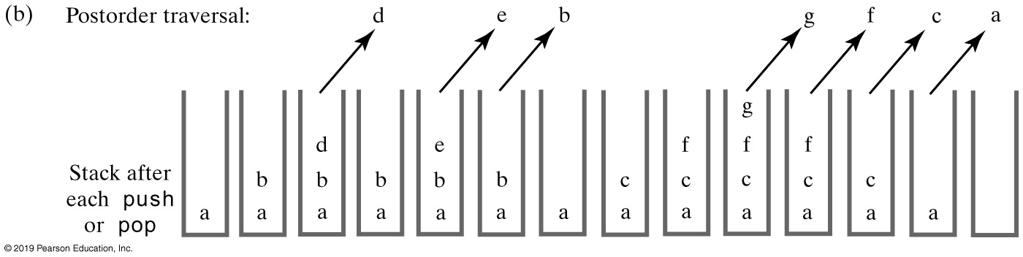
Using a Stack to Traverse a Binary Tree

Slide 26
Non-recursive Traversal
public void iterativeInorderTraverse()
{
StackInterface<BinaryNode<T>> nodeStack = new LinkedStack<>();
BinaryNode<T> currentNode = root;
while (!nodeStack.isEmpty() || (currentNode != null))
{
// Find leftmost node with no left child
while (currentNode != null)
{
nodeStack.push(currentNode);
currentNode = currentNode.getLeftChild();
} // end while
// Visit leftmost node, then traverse its right subtree
if (!nodeStack.isEmpty())
{
BinaryNode<T> nextNode = nodeStack.pop();
// Assertion: nextNode != null, since nodeStack was not empty
// before the pop
System.out.println(nextNode.getData());
currentNode = nextNode.getRightChild();
} // end if
} // end while
} // end iterativeInorderTraverse

Slide 27
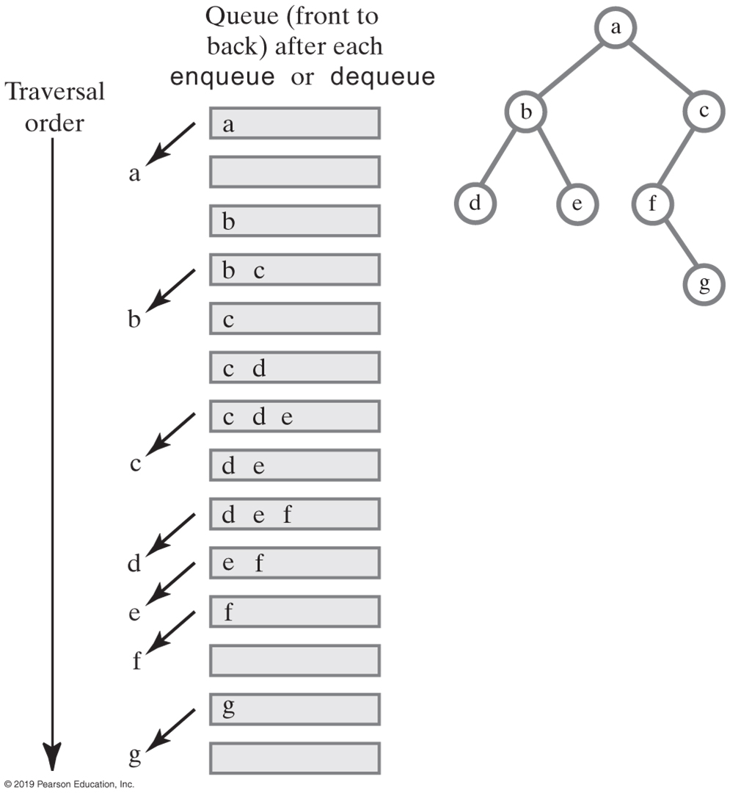
Using a Queue for Level-Order Traversal

Slide 28
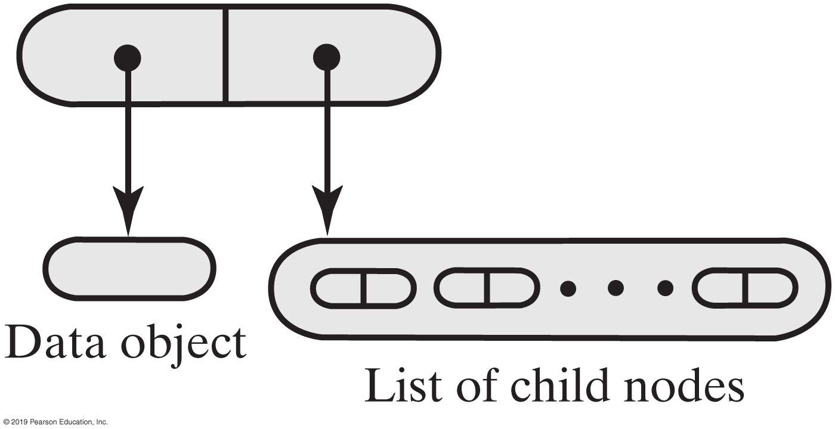
Representing General Trees
A node for a general tree

Slide 29
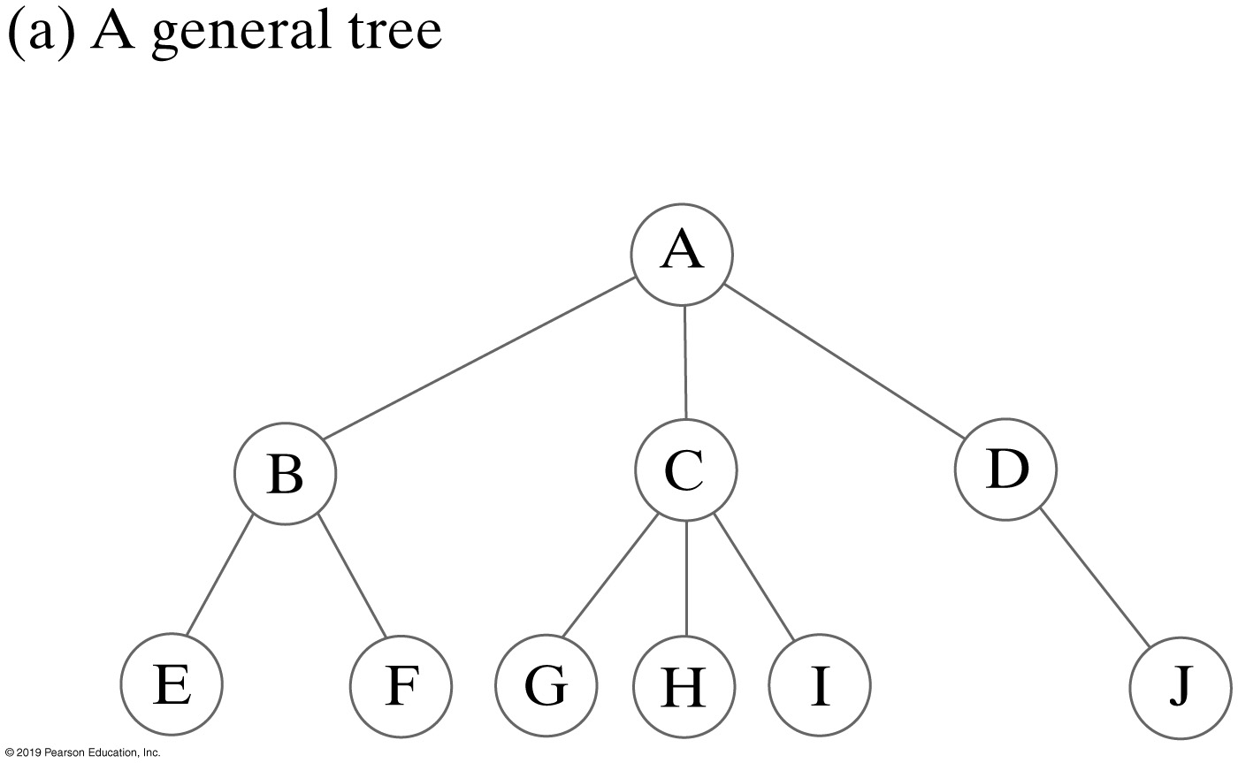
Representing General Trees

Slide 30
Representing General Trees
import java.util.Iterator;
/** An interface for a node in a general tree.*/
interface GeneralNodeInterface<T>
{
public T getData();
public void setData(T newData);
public boolean isLeaf();
public Iterator<GeneralNodeInterface<T>> getChildrenIterator();
public void addChild(GeneralNodeInterface<T> newChild);
} // end GeneralNodeInterface

